Slide 1
Creating a Chatbot
For fun and profit

Slide 2
What are we going to do?
Set up a simple web application using express and node
Create a simple web interface to capture voice as text using Web Speech API’s Speech Recognition abilities.
Send the users message to a commercial language processing API as a string
Setup Web Sockets using Socket.IO
Set up API.AI to allow for our chatbot to ‘Small Talk’
Have the web application speak the reply from the chat bot using SpeechSynthesis

Slide 3
Speech Synthesis
Methods:
speak(SpeechSynthesisUtterance) – This method should be passed an instance of SpeechSynthesisUtterance. It will then add this to the queue of utterances that need to be spoken.
cancel() – This method will remove all utterances from the queue. If an utterance is currently being spoken, it will be stopped.
pause() – This method will immediately pause any utterances that are being spoken.
resume() – This method will cause the browser to resume speaking an utterance that was previously paused.
getVoices() – This method returns a list of all the voices that are supported by the browser.
Attributes:
pending – This attribute will be set to true if there are utterances in the queue that have not yet started speaking.
speaking – This attribute will be true if an utterance is currently being spoken.
paused – This attribute will be true if an utterance is currently paused.
Usage:
utterance.text = 'Hello Treehouse';
utterance.lang = 'en-US';
utterance.volume = 1; (A float value between 0 and 1 should be specified here. The default is 1.)
utterance.rate = 1; (float value between 0 and 10, the default being 1.)
utterance.pitch = 1; (float value between 0 and 2, with a value of 1 being the default)
https://codepen.io/anon/pen/wrXwVo

Slide 4
Speech Recognition
https://codepen.io/justgooddesign/pen/kALmJ?page=1&
https://codepen.io/stlwebdev/pen/LGoZXj?page=2
https://codepen.io/aarongarciah/pen/yMBMGW?page=3
https://developer.mozilla.org/en-US/docs/Web/API/SpeechRecognition

Slide 5
The main event: Getting started
https://github.com/blakekohler/Chatterbox
npm init –f (accepts the default setting)
npm install express socket.io apiai –save
What did we just add?
- Express
(a Node.js web application server framework, to run the server locally)
Socket.io
To enable real-time bidirectional communication between the server and the browser via web sockets
Apiai
natural language processing service

Slide 6
Get set up with express
Create index.js at the root
const express = require('express');
const app = express();
app.use(express.static(__dirname + '/views')); // html
app.use(express.static(__dirname + '/public')); // js, css, images
const server = app.listen(5000);
app.get('/', (req, res) => {
res.sendFile('index.html');
});

Slide 7
Setting up speech recognition in our app
Set up our index.html and connect it to scripts.js
Add a button
<html lang="en">
<head>…</head>
<body>
…
<script src="https://cdnjs.cloudflare.com/ajax/libs/socket.io/2.0.1/socket.io.js"></script>
<script src="js/script.js"></script>
</body>
</html>
<button>Talk</button>

Slide 8
Setting up speech recognition part 2:
Invoke an instance of SpeechRecognition, the controller interface of the Web Speech API for voice recognition (add this to scripts.js)
Add event listener for the click event to start capturing speech
const SpeechRecognition = window.SpeechRecognition || window.webkitSpeechRecognition;
const recognition = new SpeechRecognition();
document.querySelector('button').addEventListener('click', () => {
recognition.start();
});

Slide 9
Setting up speech recognition part 3:
Add an event listener for a result (https://developer.mozilla.org/en-US/docs/Web/Events/result)
recognition.addEventListener('result', (e) => {
let last = e.results.length - 1;
let text = e.results[last][0].transcript;
console.log('Confidence: ' + e.results[0][0].confidence);
// We will use the Socket.IO here later…
});

Slide 10
Setting Up Socket.io
Require socket.io in your index.js
Instantiate Socket.IO in script.js
Insert code where you are listening to the result event from SpeechRecognition to emit a request.
const io = require('socket.io')(server);
const socket = io();
socket.emit('chat message', text);

Slide 11
A Natural Language Processer
Waston IBM - https://www.ibm.com/watson/
LUIS - https://www.luis.ai/home
Wit.AI https://wit.ai/
API.AI (Dialogflow) https://dialogflow.com/
intent = translation
text = how much does that cost
target = fr

Slide 12
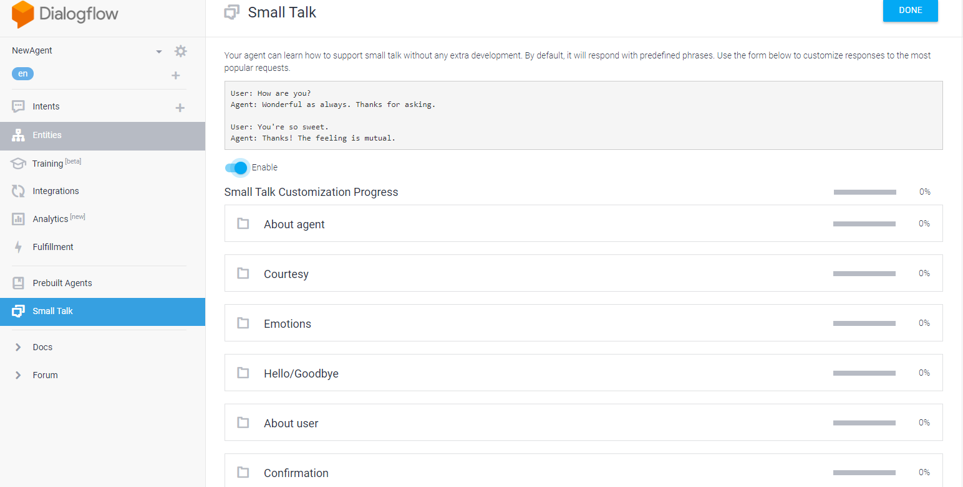
Dialogflow Setup
Create an account
Watch the getting started video
Create an agent (https://dialogflow.com/docs/getting-started/building-your-first-agent)
Setup small talk & customize your answers

Slide 13
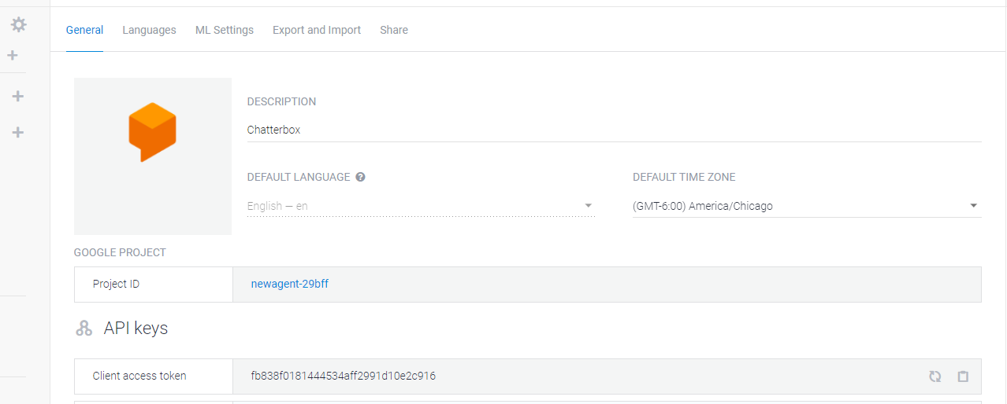
USING THE API.AI NODE.JS SDK
Add code to initialize API.AI
You’ll want to hardcode your API token – use the client access token under settings … click the cog icon
const apiai = require('apiai')(APIAI_TOKEN);

Slide 14

USING THE API.AI NODE.JS SDK
Once the connection is established and the message is received, use the API.AI APIs to retrieve a reply to the user’s message (put this in the index.js)
io.on('connection', function(socket) {
socket.on('chat message', (text) => {
// Get a reply from API.AI
let apiaiReq = apiai.textRequest(text, {
// this the developer access token from API.AI
sessionId: APIAI_SESSION_ ID
});
apiaiReq.on('response', (response) => {
let aiText = response.result.fulfillment.speech;
socket.emit('bot reply', aiText); // Send the result back to the browser!
});
apiaiReq.on('error', (error) => {
console.log(error);
});
apiaiReq.end();
}); });

Slide 15
Giving The AI A Voice With The SpeechSynthesis Interface
Create a function to generate a synthetic voice (in scripts.js)
Get the response from the server using Socket.IO again. Once the message is received, call the function.
function synthVoice(text) {
const synth = window.speechSynthesis;
const utterance = new SpeechSynthesisUtterance();
utterance.text = text;
synth.speak(utterance);
}
socket.on('bot reply', function(replyText) {
synthVoice(replyText);
});

Slide 16
What make a bot feel real? Improving our responses
https://en.wikipedia.org/wiki/Turing_completeness
https://en.wikipedia.org/wiki/Big_Five_personality_traits
day-to-day activities
schools attended
friends
holidays
places where they worked, lived, and have traveled.

Slide 17
Loebner Prize
My name is Bill. What is your name?
How many letters are there in the name Bill?
How many letters are there in my name?
Which is larger, an apple or a watermelon?
How much is 3 + 2?
How much is three plus two?
What is my name?
If John is taller than Mary, who is the shorter?
If it were 3:15 AM now, what time would it be in 60 minutes?
My friend John likes to fish for trout. What does John like to fish for?
What number comes after seventeen?
What is the name of my friend who fishes for trout?
What would I use to put a nail into a wall?
What is the 3rd letter in the alphabet?
What time is it now?

Slide 18
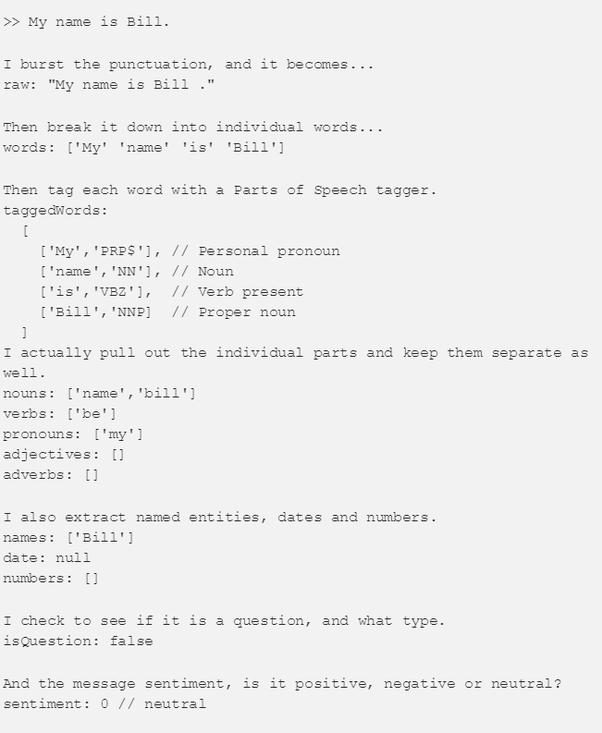
What would it take to build all of this yourself?
Normalizer: https://github.com/superscriptjs/normalizer
Expand abbreviations
Expand contractions
Convert Canadian / British to US
Fix misspelled words
Is something a question?
https://github.com/superscriptjs/qtypes
qSubType will tell us what the question format is CH, WH, YN and TG:
CH: Choice or Alternate Question. The question is asking you to pick between two or more things. For example: Is the water hot or cold?
WH: Question are the most common, they come in the form of who, what, where, when or why.
YN: Yes/No Question are fairly self explanation. For example: Do you have a pencil?
TG: Tag Question are not really questions, but are ways of asking questions to keep the conversation open. They are statements that usually end in a pronoun, and add a positive or negative ending, for example: It’s beautiful, isn’t it? or Sally went to the store, didn’t she?

